Slide 1
HR Recruitment Analysis
RECRUITMENT & TALENT DEMAND ANALYTICS

Slide 2
Project Introduction
Recruitment analytics helps organizations understand hiring demand, applicant behavior, workforce trends, and recruitment effectiveness.

Slide 3
Project Objectives
• Identify high-demand job roles
• Analyze hiring activity across companies
• Understand applicant behavior and competition
• Evaluate industry hiring trends
• Examine geographic hiring patterns

Slide 4
Dataset Overview
Job roles, company information, company size, followers, industry, work type, employment type, applicants, experience level, city/state, and job descriptions.

Slide 5
Tools & Techniques Used
Microsoft Excel
• Pivot Tables
• Pivot Charts
• Slicers
• Conditional Formatting
• Dashboard Design
• Data Visualization

Slide 6
Data Preparation & Feature Engineering
Data cleaning, standardization, company size segmentation, demand categorization, applicant intensity analysis, and dashboard preparation.

Slide 7
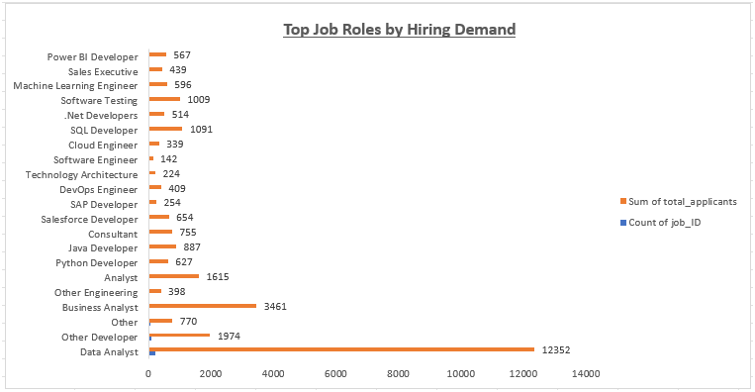
Job Role Demand Analysis
Analyze demand across job roles and applicant volume.

Slide 8
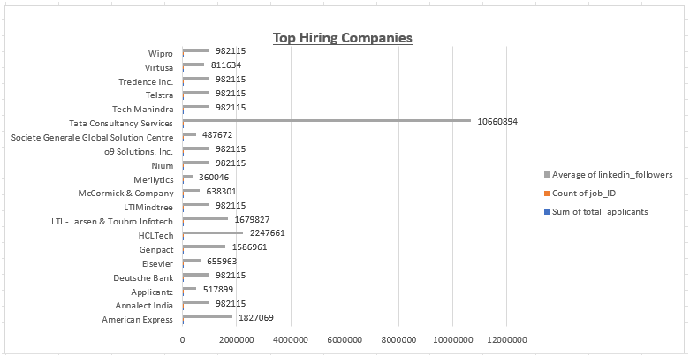
Company Hiring Insights
Evaluate hiring activity and applicant attraction.

Slide 9
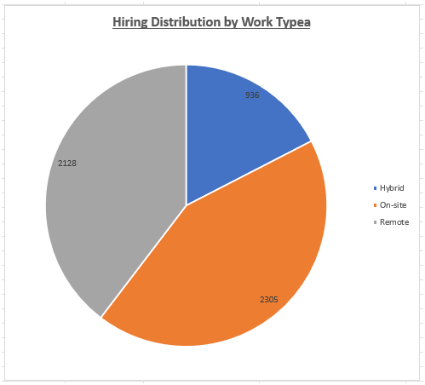
Work Type & Employment Trends
Compare remote, onsite, and hybrid opportunities.

Slide 10
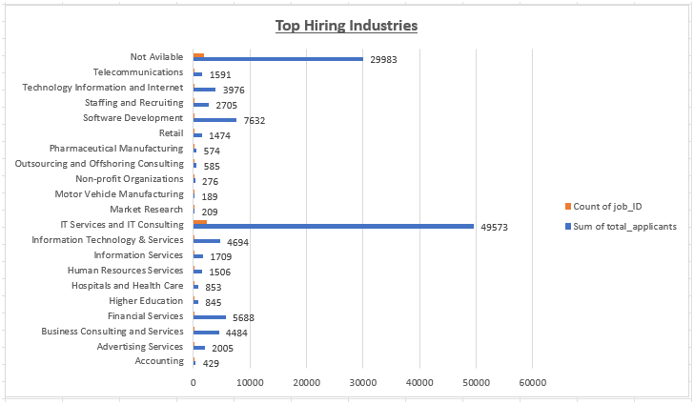
Industry-Level Hiring Analysis
Analyze hiring demand and applicant trends across different industries to identify high-growth sectors.

Slide 11
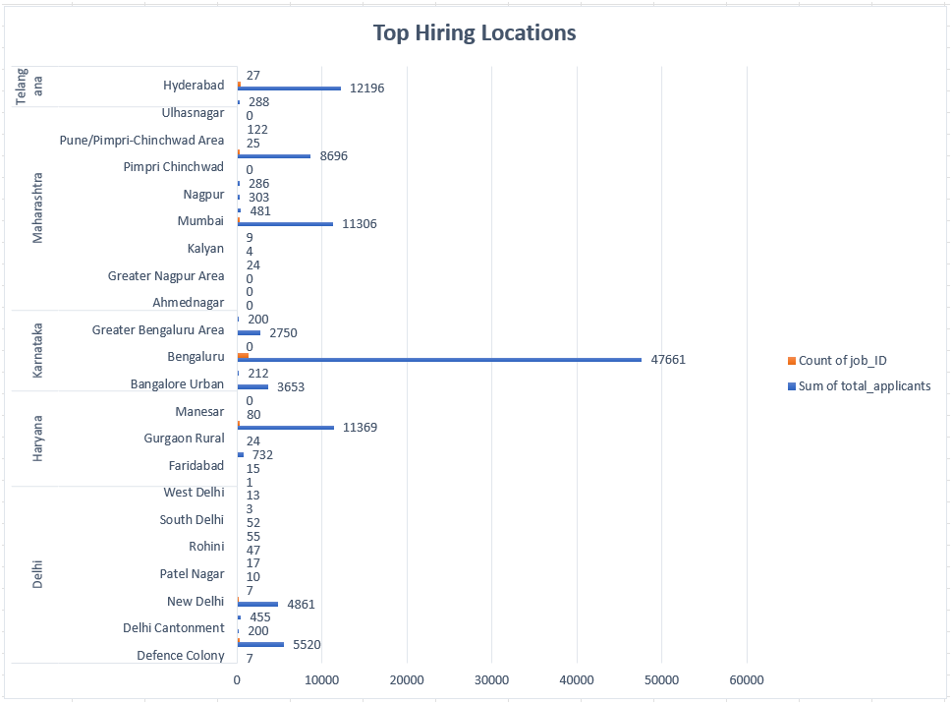
Geographic Hiring Analysis
Analyze hiring demand and applicant trends across different cities and states to identify major recruitment locations.

Slide 12
Dashboard Development
KPIs:

Slide 13
Key Business Insights
• High-demand roles attract greater competition
• Top companies receive more applicants
• Remote/hybrid jobs increase engagement
• IT sector shows highest demand
• Metro cities dominate hiring activity

Slide 14
Recommendations
Focus on high-demand talent segments, strengthen employer branding, expand hiring in growth industries, and leverage geographic insights.

Slide 15
Skills Demonstrated
HR Analytics, Recruitment Analytics, Data Cleaning, Pivot Tables, Dashboard Development, KPI Reporting, Data Visualization, Business Intelligence.

Slide 16
Conclusion
Excel-based recruitment analytics provides actionable insights for workforce planning, talent acquisition, and hiring strategy optimization.

